Slide 1
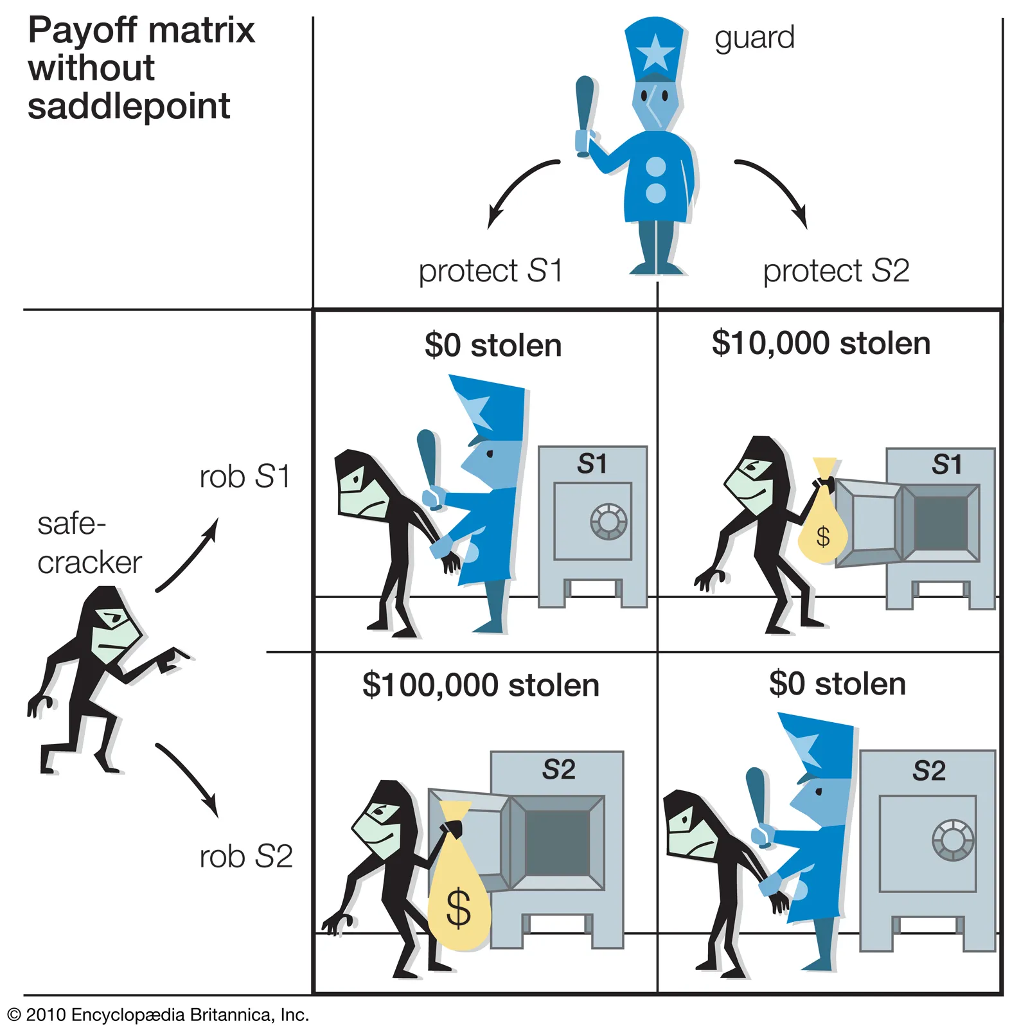
Game Theory
From
Mathematical Optimization and Economic Theory
Jacob Wyngaard

Slide 2
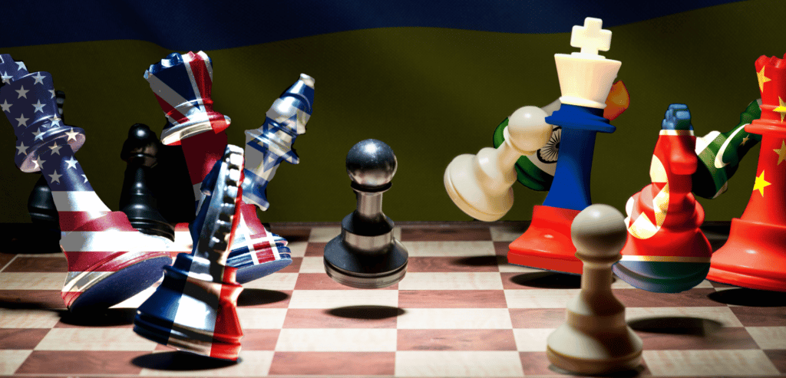
Introduction
Game Theory is a branch of economics concerned with decision making among multiple individuals whose objective functions depend upon the decisions other players make
Game Theory became popularized after John Nash’s pioneering work in the field, for which he won the Nobel Prize
Game Theory has since been used for US nuclear weapon strategy, sports modeling, negotiation, and much more

Slide 3
Terminology
Game theory is so named because of the similarity to common games of strategy like poker, chess, and tic-tac-toe
players - the decision makers
payoff functions – the objective functions of the players
*The payoff function of each player maps the profile of player strategies to a payoff
move – a point where a player must make a choice.
play – a particular set of moves and choices
strategy – a predetermined set of decisions which provide a choice for each move

Slide 4
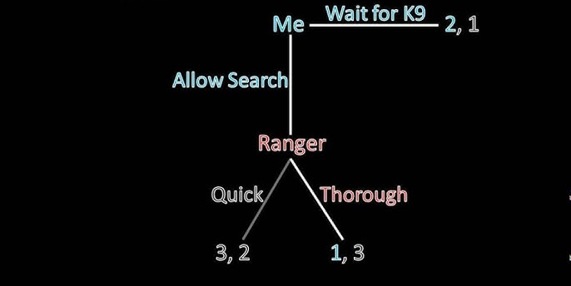
Forms of Game Theory
Games in Extensive Form
When a game involves decisions made in sequence, it is described as a game in extensive form
The moves and corresponding payoffs are shown in a decision tree:

Slide 5
Forms of Game Theory
Games in Extensive Form
Decision trees are solved backwards: you assume that each player makes the move that maximizes their payoff
Ranger picks Thorough
Wait for K9
Me
2,1
Allow Search
1,3
You choose Wait for K9

Slide 6
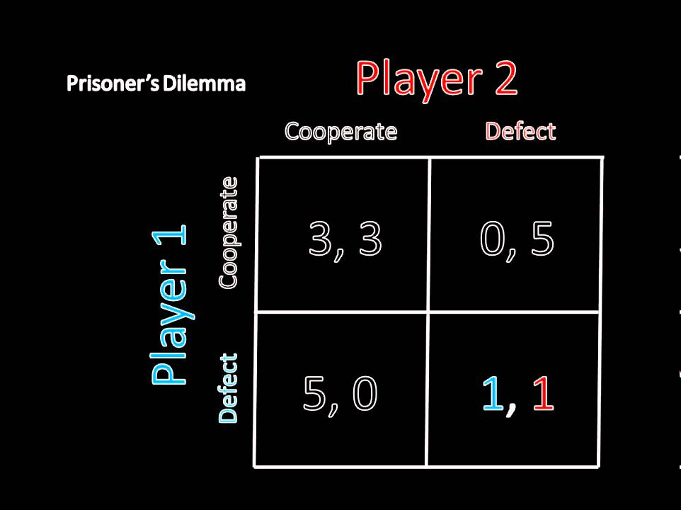
Forms of Game Theory
Games in Normal Form
Games in normal form involve player decisions made independently and/or simultaneously
The moves and corresponding payoffs are shown in a payoff matrix:
*We assume that all players know the payoff matrix

Slide 7
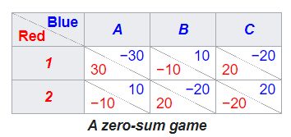
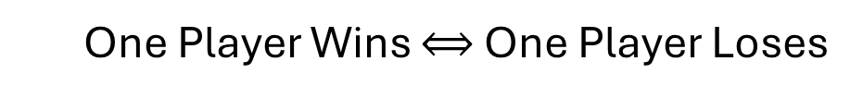
Two Player Zero Sum Games
One Player Wins $⟺$ One Player Loses
-2
-1
-4
2
1
4
2
1
4
1
0
-6
-1
0
6
-1
0
6
Because of the zero-sum, we only display Player 1’s (Red’s) payoffs

Slide 8
Two Player Zero Sum Games
Each player chooses their strategy based on the best worst-case scenario
They compute the worst outcome for each of their decisions
They choose the decision with the best worst outcome
Player 1 (Red) Strategy Selection
2
1
4
Worst Case: 1
Choose strategy 1
-1
0
6
Worst Case: -1

Slide 9
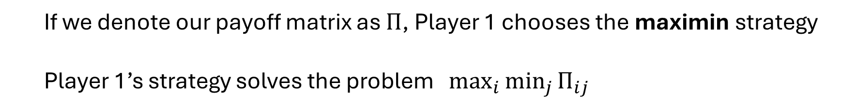
Two Player Zero Sum Games
Player 1 (Red) Strategy Selection
20
30
4
2
-10
1
Worst Case: 1
Choose strategy 1
-10
-20
Worst Case: -1
-1
20
0
6
If we denote our payoff matrix as $Π$, Player 1 chooses the maximin strategy
Player 1’s strategy solves the problem $\max_{i}{\min_{j}{Π_{ij}}}$
Worst Case
Best

Slide 10
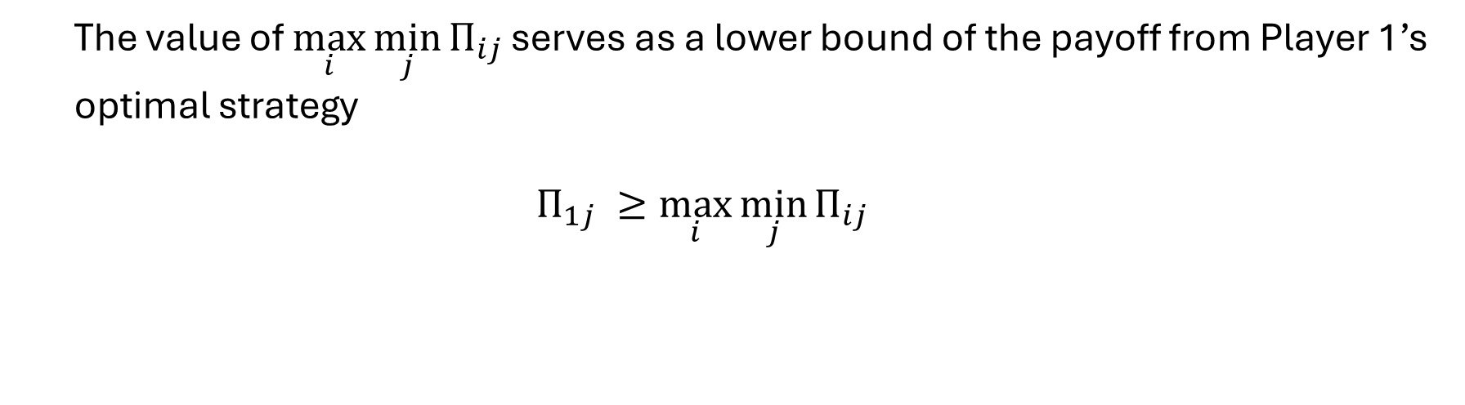
Two Player Zero Sum Games
Player 1 (Red) Strategy Selection
20
2
1
4
30
-10
Worst Case: 1
Choose strategy 1
-1
0
-20
-10
20
6
Worst Case: -1
The value of $\max_{i}{\min_{j}{Π_{ij}}}$ serves as a lower bound of the payoff from Player 1’s optimal strategy
$$Π_{1j} ≥\max_{i}{\min_{j}{Π_{ij}}}$$

Slide 11
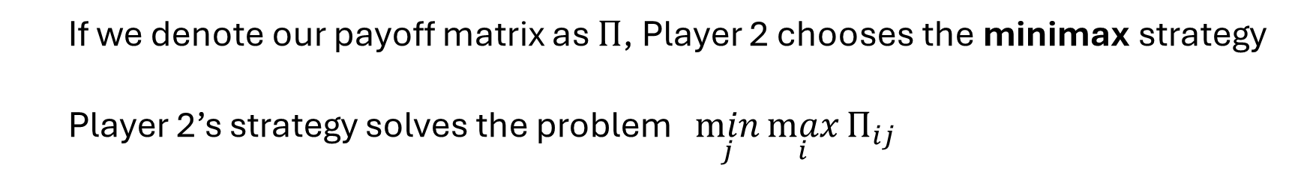
Two Player Zero Sum Games
Player 2 (Blue) Strategy Selection
20
2
1
4
30
-10
-1
0
-20
-10
20
6
Worst Case: 2
Worst Case: 1
Worst Case: 4
Choose strategy B
If we denote our payoff matrix as $Π$, Player 2 chooses the minimax strategy
Player 2’s strategy solves the problem $\min_{j}{\max_{i}{Π_{ij}}}$
Best
Worst Case

Slide 12
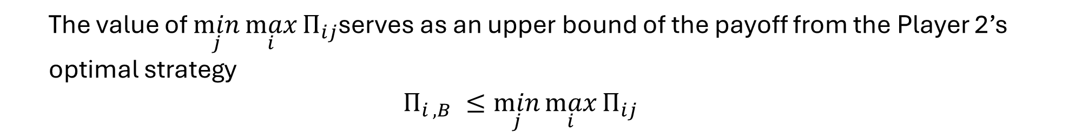
Two Player Zero Sum Games
Player 2 (Blue) Strategy Selection
20
30
4
2
-10
1
-10
-20
-1
20
0
6
Worst Case: 2
Worst Case: 1
Worst Case: 4
Choose strategy B
The value of $\min_{j}{\max_{i}{Π_{ij}}}$serves as an upper bound of the payoff from the Player 2’s optimal strategy
$$Π_{i ,B} ≤\min_{j}{\max_{i}{Π_{ij}}}$$

Slide 13
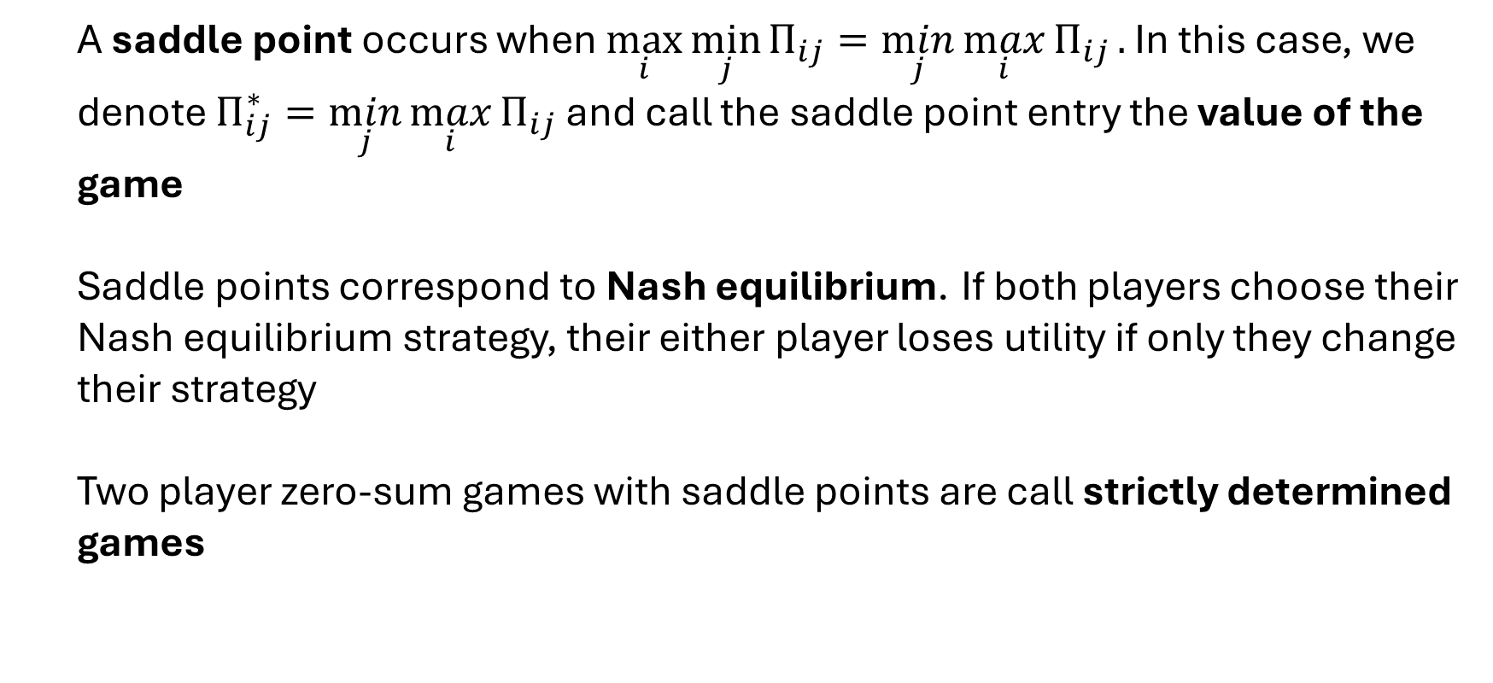
Saddle Points
A saddle point occurs when $\max_{i}{\min_{j}{Π_{ij}}}=\min_{j}{\max_{i}{Π_{ij}}}.$ In this case, we denote $Π_{ij}^{∗}=\min_{j}{\max_{i}{Π_{ij}}}$ and call the saddle point entry the value of the game
Saddle points correspond to Nash equilibrium. If both players choose their Nash equilibrium strategy, their either player loses utility if only they change their strategy
Two player zero-sum games with saddle points are call strictly determined games

Slide 14
Two Player Zero Sum Games
Strict Dominance
We can also solve for the Saddle Point by eliminating strictly dominated strategies
20
20
30
4
4
2
-10
1
30
2
-10
1
-10
-20
-20
-1
20
0
-10
-1
20
6
0
6
20
20
30
4
4
2
-10
1
30
2
-10
1
-10
-20
-20
-1
20
0
-10
-1
20
6
0
6

Slide 15
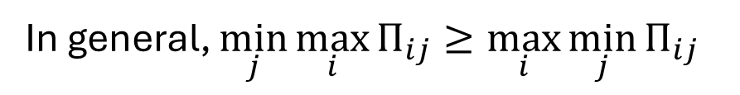
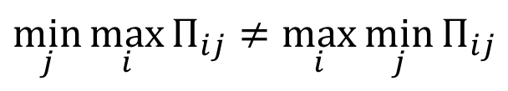
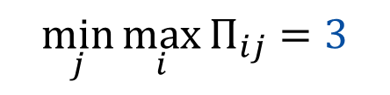
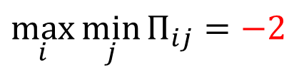
Existence of Saddle Points
Saddle points don’t necessarily exist
Consider the payoff matrix:
$$\max_{i}{\min_{j}{Π_{ij}}=−2}$$
$$\min_{j}{\max_{i}{Π_{ij}}=3}$$
$$\min_{j}{\max_{i}{Π_{ij}}≠\max_{i}{\min_{j}{Π_{ij}}}}$$
20
30
3
6
-10
-2
There’s no saddle point!
-10
-20
-4
20
5
4
In general, $\min_{j}{\max_{i}{Π_{ij}}≥\max_{i}{\min_{j}{Π_{ij}}}}$

Slide 16
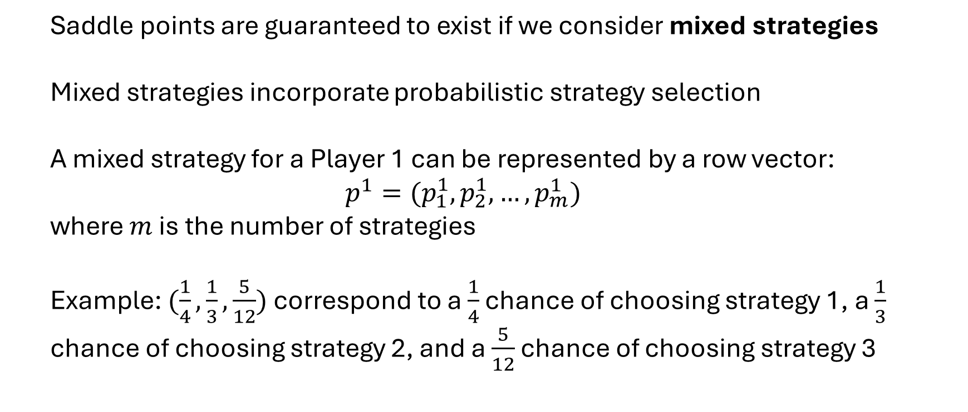
Existence of Saddle Points
Saddle points are guaranteed to exist if we consider mixed strategies
Mixed strategies incorporate probabilistic strategy selection
A mixed strategy for a Player 1 can be represented by a row vector:
$$p^{1}=(p_{1}^{1},p_{2}^{1},…,p_{m}^{1})$$
where $m$ is the number of strategies
Example: $(\frac{1}{4},\frac{1}{3},\frac{5}{12})$ correspond to a $\frac{1}{4}$ chance of choosing strategy 1, a $\frac{1}{3}$ chance of choosing strategy 2, and a $\frac{5}{12}$ chance of choosing strategy 3

Slide 17
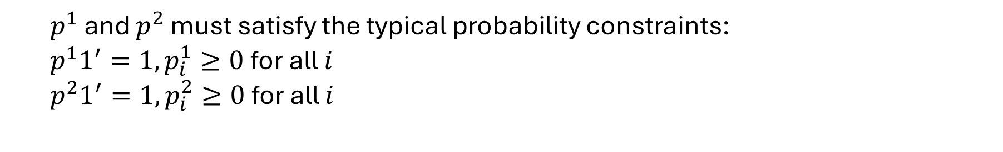
Minimax Theorem
Player 1 now seeks the expected best worst-case scenario: $\max_{p^{1}}{\min_{j}{p^{1}Πe_{j}′}}$
Player 2 now seeks the expected best worst-case scenario: $\min_{p^{2}}{\max_{i}{e_{i}Πp^{2}′}}$
$p^{1}$ and $p^{2}$ must satisfy the typical probability constraints:
$p^{1}1^{′}=1,p_{i}^{1}≥0$for all $i$
$p^{2}1^{′}=1,p_{i}^{2}≥0$for all $i$
According to Minimax Theorem, all two-player zero-sum finite games have a solution if mixed strategies are allowed

Slide 18
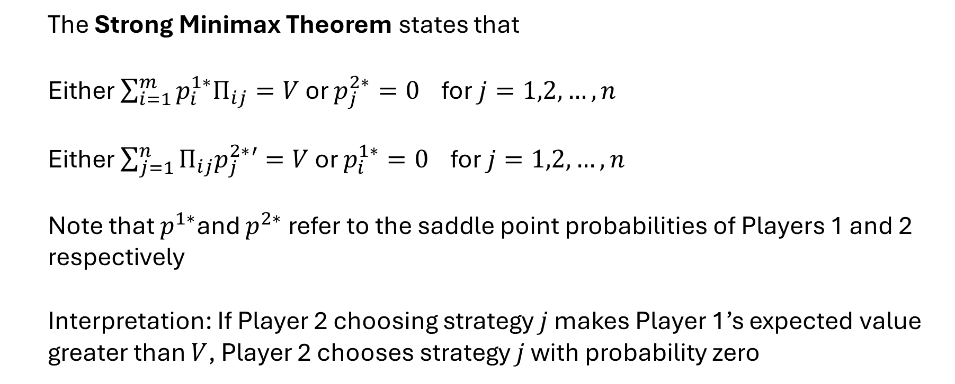
Strong Minimax Theorem
The Strong Minimax Theorem states that
Either $\sum_{i=1}^{m}{p_{i}^{1∗}Π_{ij}=V}$ or $p_{j}^{2∗}=0$ for $j=1,2,…,n$
Either $\sum_{j=1}^{n}{Π_{ij}p_{j}^{2∗}′=V}$ or $p_{i}^{1∗}=0$ for $j=1,2,…,n$
Note that $p^{1∗}$and $p^{2∗}$refer to the saddle point probabilities of Players 1 and 2 respectively
Interpretation: If Player 2 choosing strategy $j$ makes Player 1’s expected value greater than $V$, Player 2 chooses strategy $j$ with probability zero

Slide 19
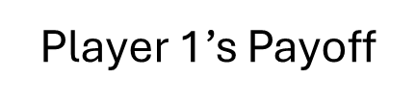
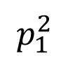
Finding the Saddle Point Graphically
Player 1’s Payoff
A
C
20
30
3
6
-10
-2
-10
-20
$$p_{1}^{2}$$
-4
20
5
4
B

Slide 20
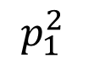
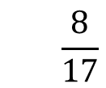
Finding the Saddle Point Graphically
Player 1’s Payoff
Again, we go back to the best worst-case scenario
A
C
Graphically, the worst case corresponds to the lowest line
The Saddle Point
$$p_{1}^{2}$$
$$\frac{8}{17}$$
the lowest line
B
We then find the highest point on the lowest line

Slide 21
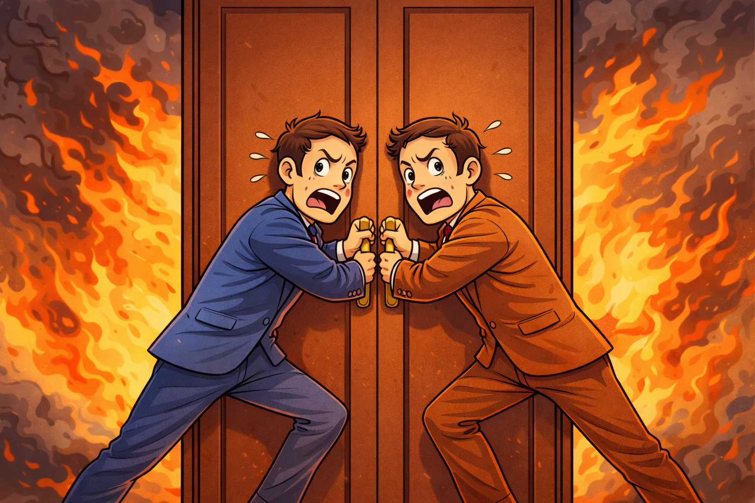
Two-Person Non-Zero Sum
In some games, one player’s win doesn’t necessarily require another player’s loss
In some of these games, cooperation may result in better outcomes for both players
Push Against Door
Don’t Push Against Door
Push Against Door
100, 100
-100, -100
Don’t Push Against Door
-100, -100
-100, -100

Slide 22
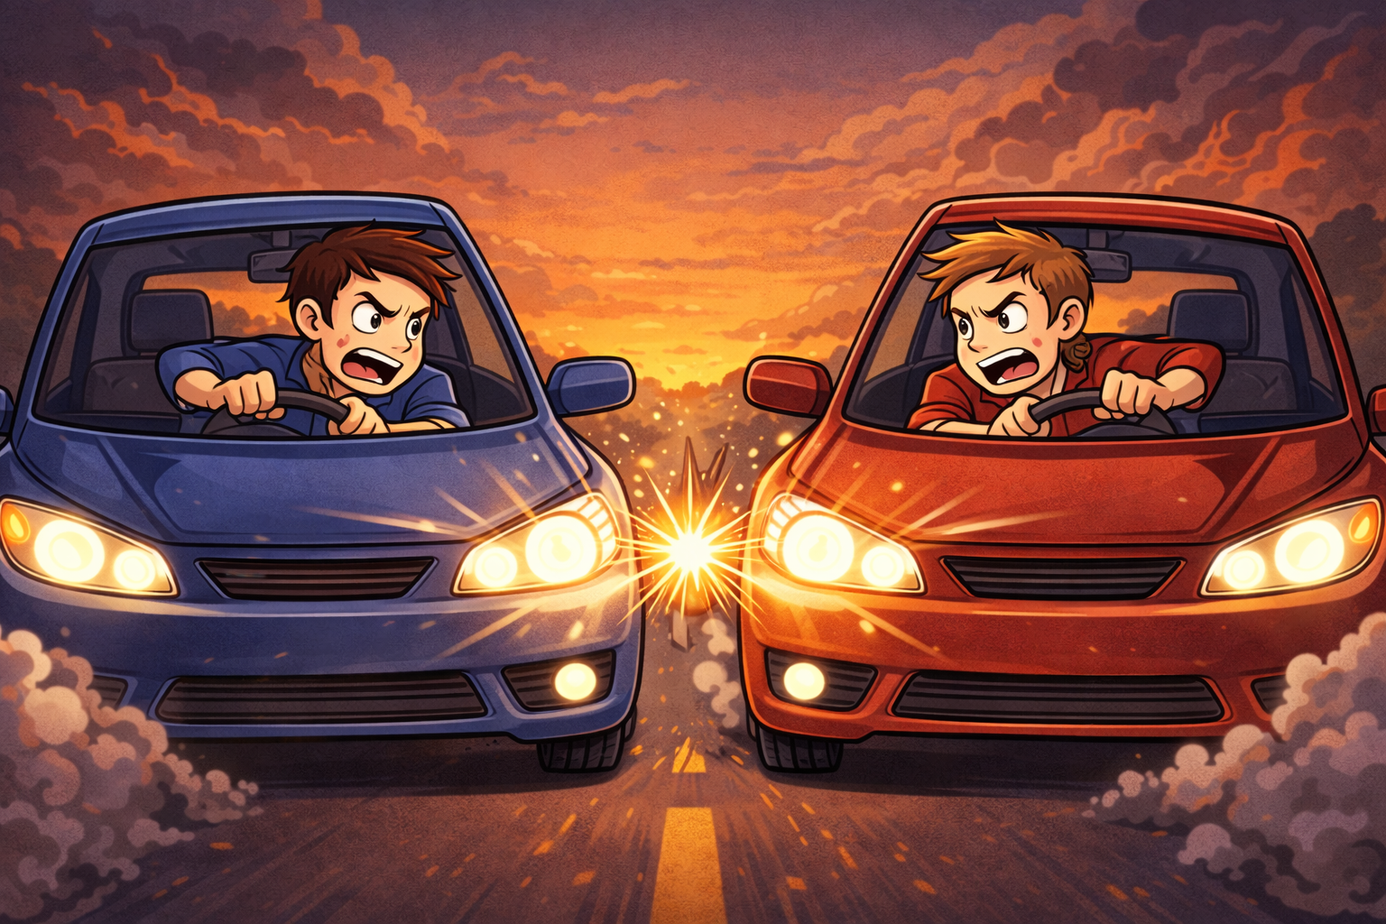
Two-Person Non-Zero Sum
In other non-zero sum games, the existence of a “mutually assured” destruction scenario inspires certain bluffing strategies
Swerve
Don’t Swerve
Swerve
0, 0
-5, 5
Don’t Swerve
5, -5
-100, -100

Slide 23

A Beautiful Math
In 1950, John Nash proved that a mixed strategy equilibrium exists for every game with a finite number of players and strategies
This extended the Minimax Theorem of Von Neumann, which had only focused on zero-sum two player games

Slide 24
Cooperative Games
A cooperative game allows players to discuss their strategies before play and make binding agreements
The Nash cooperative solution involves cooperative games without side payments; i.e. I can’t pay a player to adopt a certain strategy
If the players fail to cooperate, each player receives a threat payoff

Slide 25
Nash Cooperative Solution
Nash specified four assumptions for the solution to be unique:
Symmetry – solution doesn’t depend on numbering of players
Independence of Linear Transformations (of the payoffs)
Independence of Irrelevant Alternatives – solution is the same if we delete unused potential choices
Pareto optimality - there is not another feasible set of payoffs in which one or both players are better off without negatively affecting the other player

Slide 26
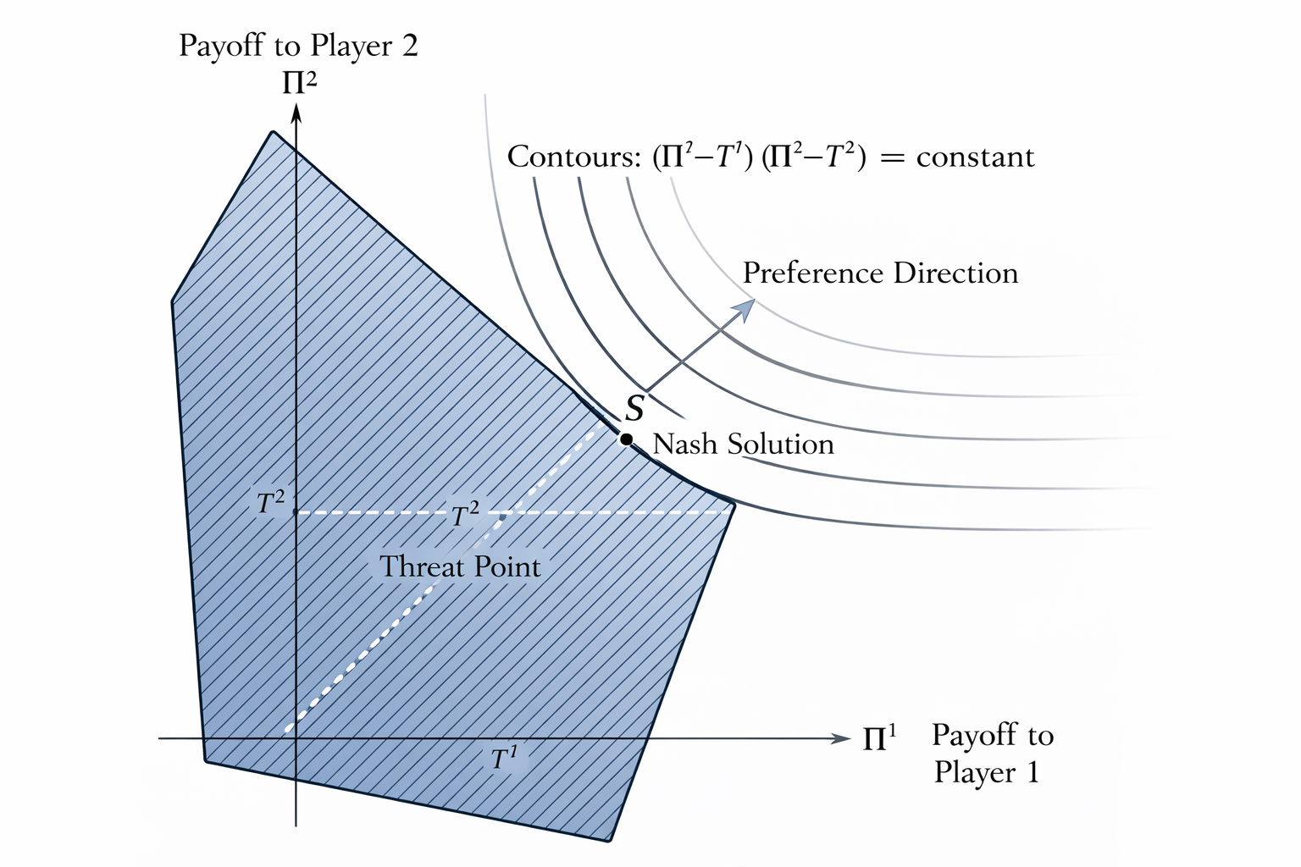
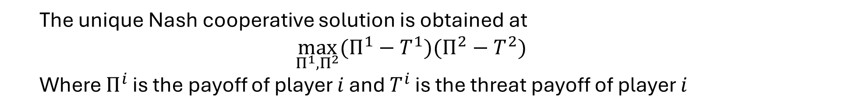
Nash Cooperative Solution
The unique Nash cooperative solution is obtained at
$$\max_{Π^{1},Π^{2}}{(Π^{1}−T^{1})(Π^{2}−T^{2})}$$
Where $Π^{i}$ is the payoff of player $i$ and $T^{i}$ is the threat payoff of player $i$

Slide 27
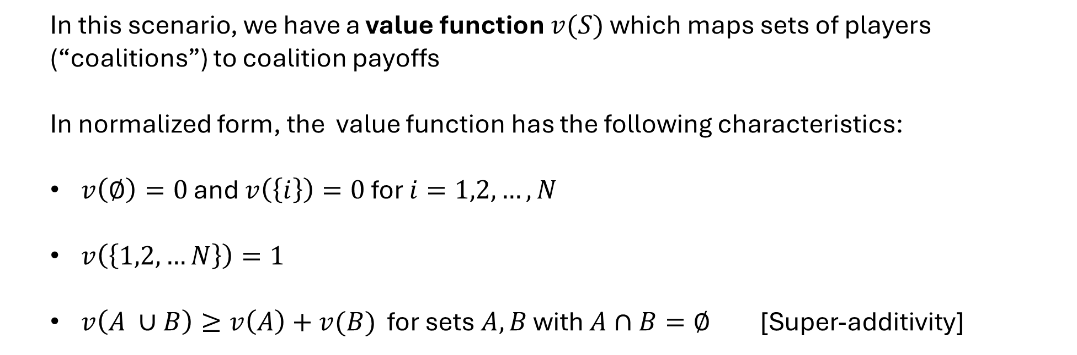
Cooperative Games with Side Payments
Since side payments can be made within each coalition, we only need to consider the total payoff a coalition makes (the size of the pie)
In this scenario, we have a value function $v(S)$ which maps sets of players (“coalitions”) to coalition payoffs
In normalized form, the value function has the following characteristics:
$v\left(∅\right)=0$ and $v\left(\left\{i\right\}\right)=0$ for $i=1,2,…,N$
$v\left(\left\{1,2,…N\right\}\right)=1$
$v\left(A ∪B\right)≥v\left(A\right)+v(B)$ for sets $A,B$ with $A∩B=∅$ [Super-additivity]

Slide 28
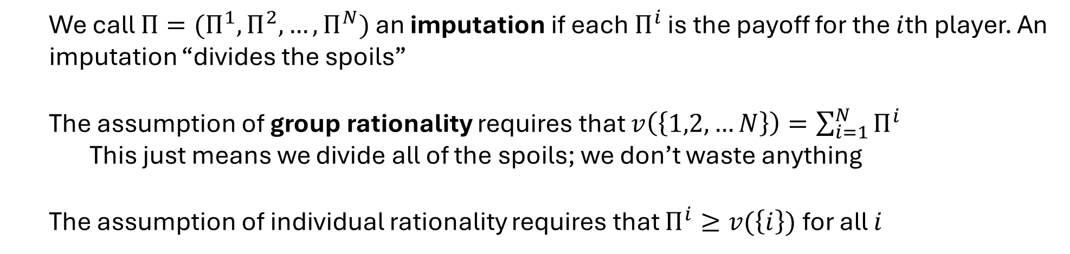
Imputations and Rationality
We call $Π=(Π^{1},Π^{2},…,Π^{N})$ an imputation if each $Π^{i}$ is the payoff for the $i$th player. An imputation “divides the spoils”
The assumption of group rationality requires that $v\left(\left\{1,2,…N\right\}\right)=\sum_{i=1}^{N}{Π^{i}}$
This just means we divide all of the spoils; we don’t waste anything
The assumption of individual rationality requires that $Π^{i}≥v(\left\{i\right\})$ for all $i$

Slide 29
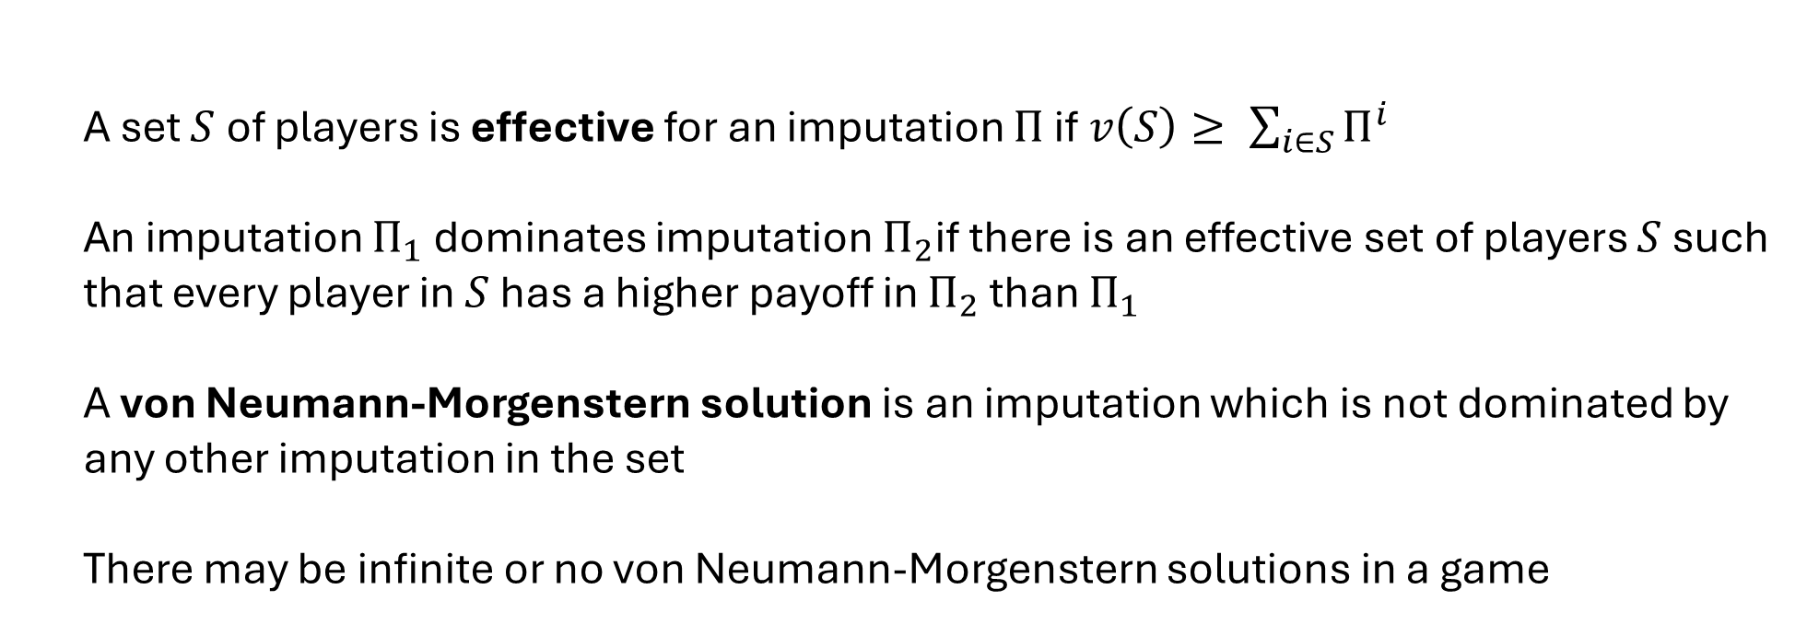
Effective Coalitions
A set $S$ of players is effective for an imputation $Π$ if $v\left(S\right)≥ \sum_{i∈S}{Π^{i}}$
An imputation $Π_{1}$ dominates imputation $Π_{2}$if there is an effective set of players $S$ such that every player in $S$ has a higher payoff in $Π_{2}$ than $Π_{1}$
A von Neumann-Morgenstern solution is an imputation which is not dominated by any other imputation in the set
There may be infinite or no von Neumann-Morgenstern solutions in a game

Slide 30
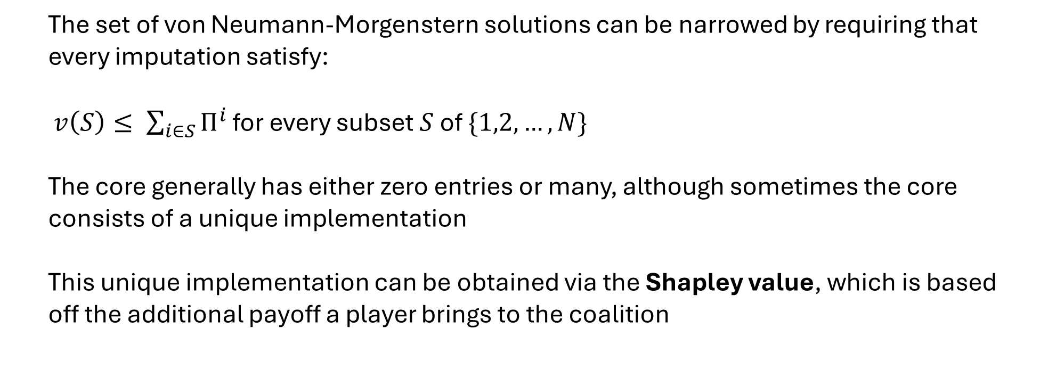
The Core
The set of von Neumann-Morgenstern solutions can be narrowed by requiring that every imputation satisfy:
$v\left(S\right)≤ \sum_{i∈S}{Π^{i}}$ for every subset $S$ of $\{1,2,…,N\}$
The core generally has either zero entries or many, although sometimes the core consists of a unique implementation
This unique implementation can be obtained via the Shapley value, which is based off the additional payoff a player brings to the coalition

Slide 31
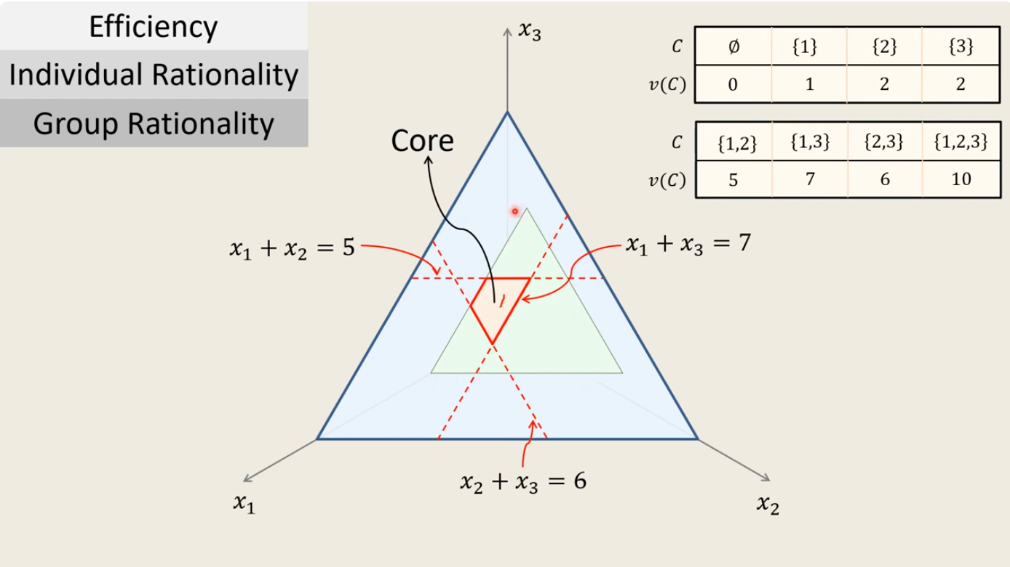
The Core

Slide 32
Games with Infinitely Many Players
Under certain assumptions about the game and how the number of players grows, all of the different solution concepts from this chapter all converge to the same solution as the number of players grows to infinity
With infinitely many players, there will always exist an equilibrium point
The Shapely value converges to the same limit as the core
Game Theory has the most satisfactory analysis for games of two players or infinite players…much like Classical Mechanics

